Slide 1
Enhancing Information Security & IT Governance through a robust IS Auditing Program
Part 1: Corporate Operational benefits,
Non-technical information for FSOs and ISSMs/ISSOs
Part 2: Technical Tips on how to conduct a better audit review
Jose Neto - CISSP, PMP, GPEN, CASP, CompTIA SME

Slide 2
Glossary
Protecting your most valuable asset.
What is IT Governance?
How intense should my auditing efforts be?
Quality audit reviews vs quick-glance reviews
Auditing tools, auditing scripts and other automation techniques.
Questions/Feedback

Slide 3
Protecting your most valuable asset
In our current information age, what would you consider the most coveted or valuable asset?
Proprietary, Intellectual, and Classified Information
Over the past 12 months virtually every industry sector has been hit with some type of cyber threat.
Notes:
https://www.dol.gov/ebsa/pdf/erisaadvisorycouncil2015security3.pdf

Slide 4
Commercial Exploits
Entertainment Industry
Food Service Industry
Retail Office Supplies
Financial
Health Care
Academia
Travel – Airlines
Social Connectivity
Exchanges
Defense Contractors
Notes:
Sensitivity of the companies
Heritage.org

Slide 5
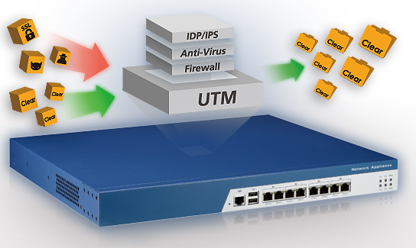
Global IT Security Spending
$7.1 Billion in 2014 (Gartner)
8.2% growth to reach $76.9 Billion
Security countermeasures
Firewalls
IDS/IPS
Security Software
Network security appliances

Slide 6
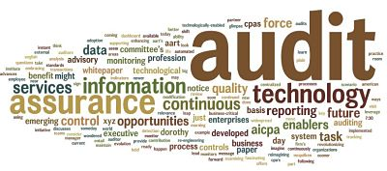
Collecting SBI (Security Business Intelligence)
The implementation of these network security appliances will reduce the attack surface, but will not provide SBI without a comprehensive Information Systems Audit program.

Slide 7
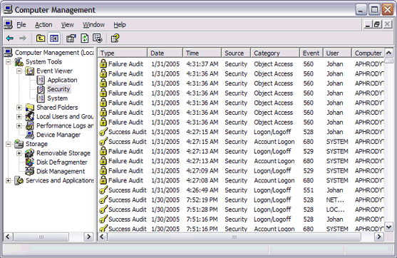
Misconception of IS Auditing
Notes:
More than just log review

Slide 8
Business Challenge
Identify the need to protect information
Determine the proper access level for administrators and users
Implement and enforce the resulting policy
Monitor the information collected

Slide 9
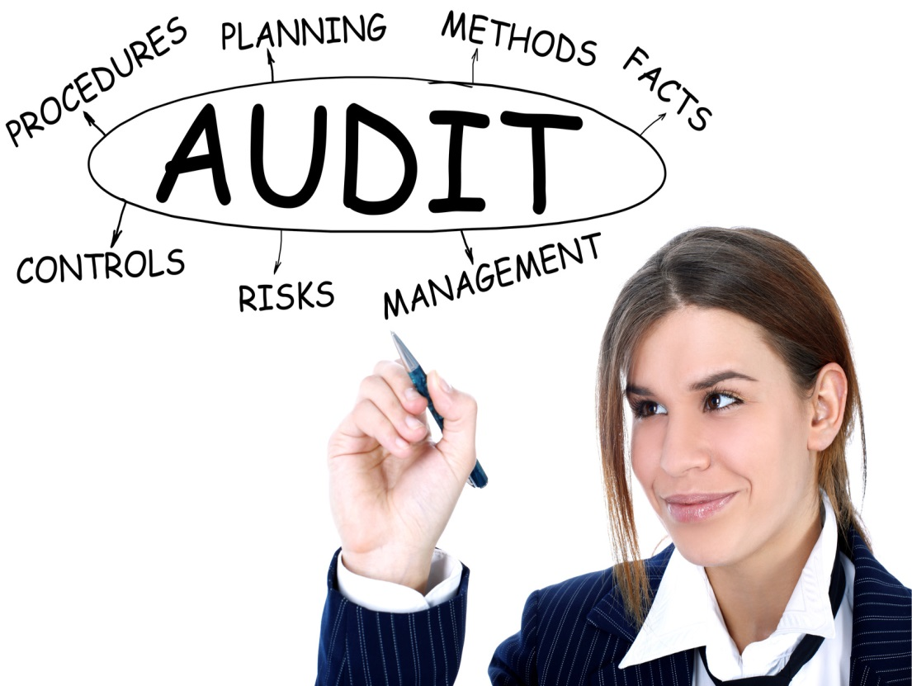
What exactly is Auditing and IS Auditing?
Information Systems Audit refers to any audit that encompasses wholly or partly the review and evaluation of automated information processing systems, related non-automated processes and the interfaces among them.
Notes:
The most common definition is in the financial industry
An official examination and verification of accounts and records of financial accounts.

Slide 10
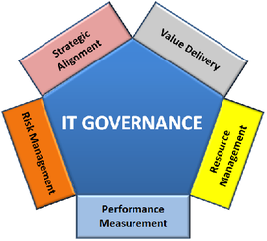
IT Governance, Risk and IS Auditing
Ensuring an enterprise’s strategic objectives are not jeopardized by IT failures.
Notes:
The biggest challenge with IS Auditing is enumerating the delivery of value through IS Auditing. SBI - This discussion goes beyond compliance, there are various benefits in having a robust auditing program.

Slide 11
Proper log configuration
The first step begins with the proper configuration management of the system’s log settings.
Having access to event information will provide the ability to discover and investigate suspicious system, security or application activity.
The success of the IS Audit program will depend on the quality of the analysis and review of the logs.

Slide 12
NIST Objectives for Audit Trails
Individual Accountability
Alerting users that they are personally accountable for the actions.
Reconstruction of events
This can be used to troubleshoot problems and determine if the problem was triggered by the user or the system.
Intrusion detection
This refers to the process of identifying attempts to penetrate a system or unauthorized access.
Notes:
http://csrc.nist.gov/publications/nistbul/itl97-03.txt
SP800-92

Slide 13
The need for auditing
No matter how small or how complex a system is, how can you be certain and confident on your security program unless someone is properly monitoring it.

Slide 14
Comprehensive IS Auditing
Audit account logon events
Audit account management
Audit directory service access
Audit object access
Audit policy change
Audit privilege use
Audit process tracking
Audit system events
Notes:
Audit account logon events – audit each instance of a user logging on to or logging off from another computer in which this computer is used to validate the account. This event category is applicable to domain controllers only since DC’s are used to validate accounts in domains.
Audit account management – audit each event of account management on a computer. Examples of account maintenance include password changes, user account and group modifications.
Audit directory service access – audit the event of a user accessing an Active Directory object that has its own system access control list (SACL) specified.
Audit object access – audit the event of a user accessing an object that has its own system access control list (SACL) specified. Examples of objects are files, folders, registry keys, printers, etc.
Audit policy change – audit every incident of a change to user rights assignment policies, audit policies, or trust policies.
Audit privilege use – audit each instance of a user exercising a user right.
Audit process tracking – audit detailed tracking information for events such as program activation, process exit, handle duplication, and indirect object access.
Audit system events – audit when a user restarts or shuts down the computer or when an event occurs that affects either the system security or the security log.
https://www.petri.com/windows_auditing

Slide 15
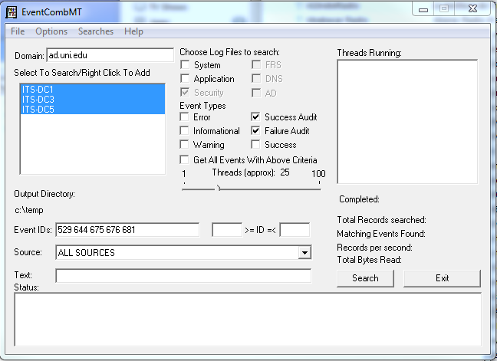
Event Comb MT
Event Comb MT (Windows 2003/2008 environments)
Collect and parse windows events from multiple event logs on different computers.
Notes:
http://social.technet.microsoft.com/wiki/contents/articles/4585.account-locked-out-troubleshooting-eventcombmt.aspx

Slide 16
PowerShell (Windows 2003/7/2008 environments)
Windows PowerShell is a task automation and configuration management framework from Microsoft, consisting of a command-line shell and associated scripting language built on the .NET Framework.
#Get all Security Events
Get-EventLog security
#Windows 2008
Get-EventLog -log Security | ? EventID -EQ 4740 #Windows 2003
Get-EventLog -log Security | ? EventID -EQ 644
Notes:
http://windowsitpro.com/powershell/access-security-event-logs-powershell

Slide 17
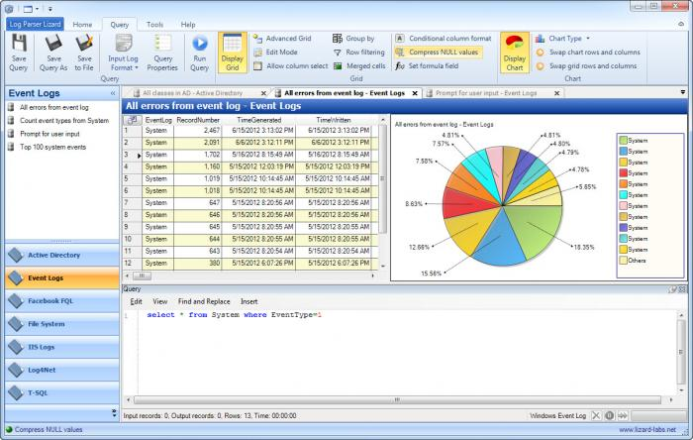
Log Parser and Log Parser Studio
Free Microsoft Tool to collect, filter events in an SQL-like environment. The tool also has the ability to create reports and graphic charts.

Slide 18
Advanced Auditing tips & tricks
Check for Event ID 12294 in the “system log” instead of the “security log”, because the account lockout threshold is not applicable to the default administrator account.
Check for Event ID 627 “Change password attempt”. Ensure that both the Primary account name to Target Account name are both the same, otherwise this represents a third party attempting to change credentials.
Check for Event ID 628 “User account password reset”. Records the reset of a password through and administrative interface such as active directory.
Notes:
Reference: The security Monitoring and Attack Detection planning Guide.

Slide 19
Advanced Auditing tips & tricks continued..
Check for Event ID 624 “Creating a user account”. Monitor that only authorized individuals create new accounts.
Check for Event ID 642 “Changing a user account”. Monitor that only authorized individuals can modify security-related properties.
Check for Event ID 576 “Special Privileges assigned to new logon”. Monitor this ID for new sessions that possess administrator level access.

Slide 20
Questions
?

